Slide 1


Slide 2
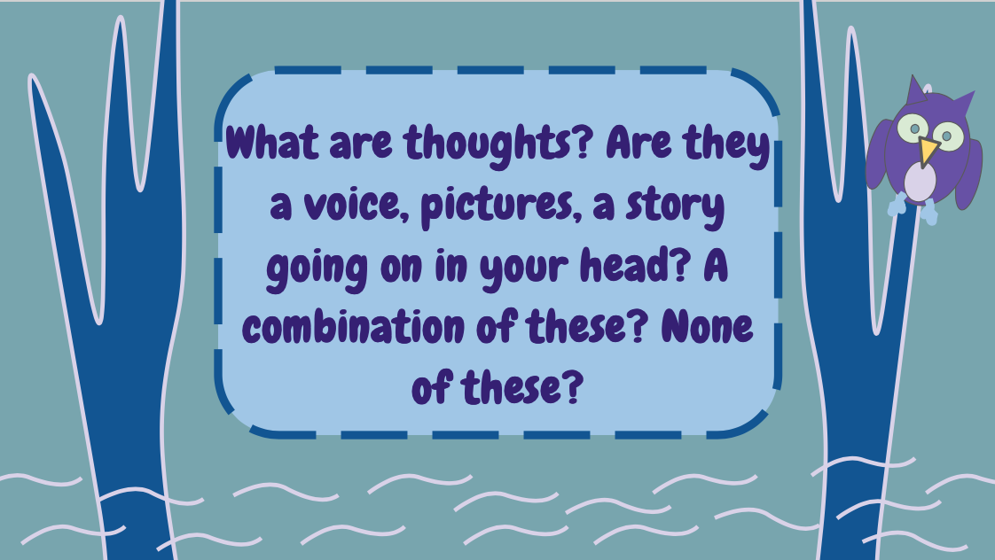

Slide 3


Slide 4
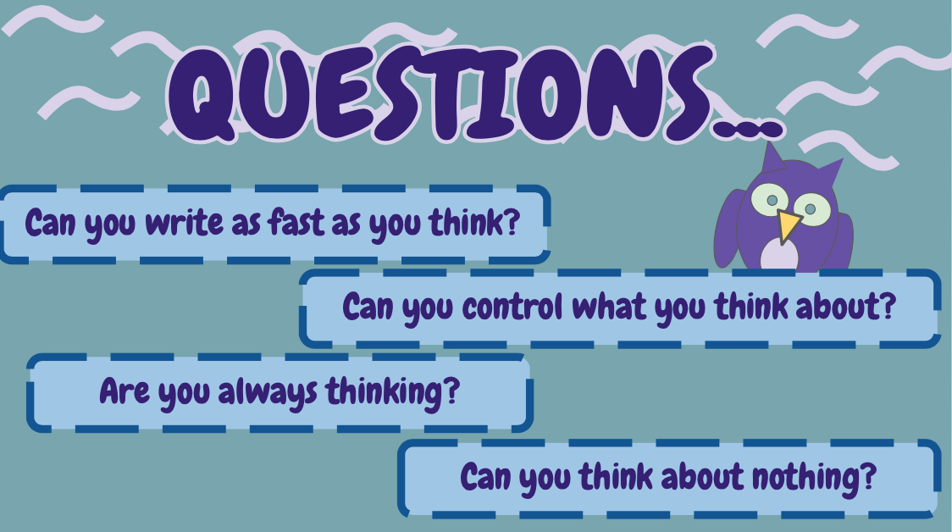

Slide 5
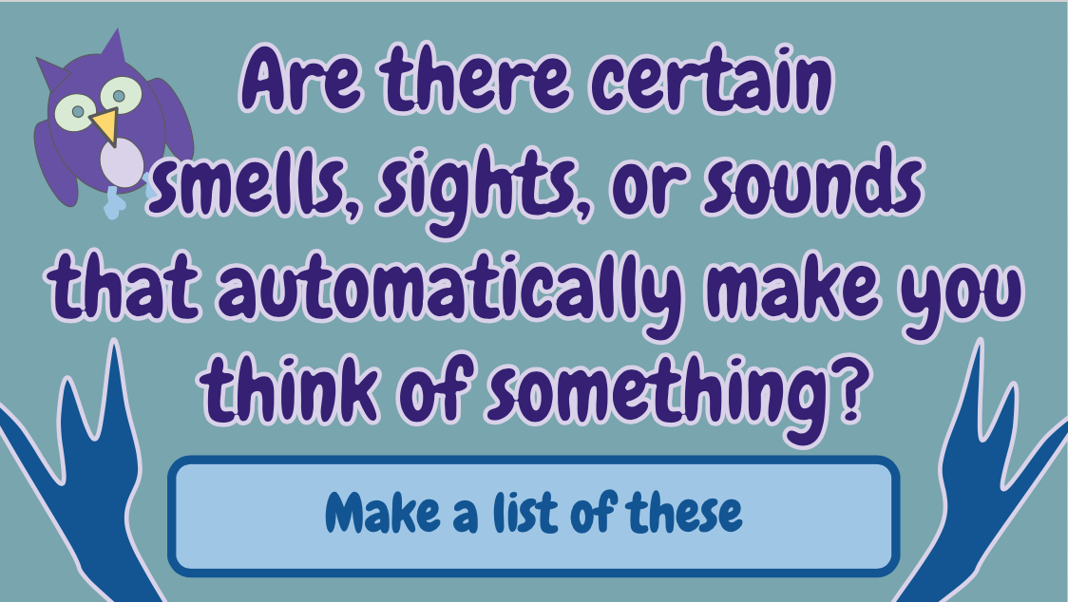

Slide 6
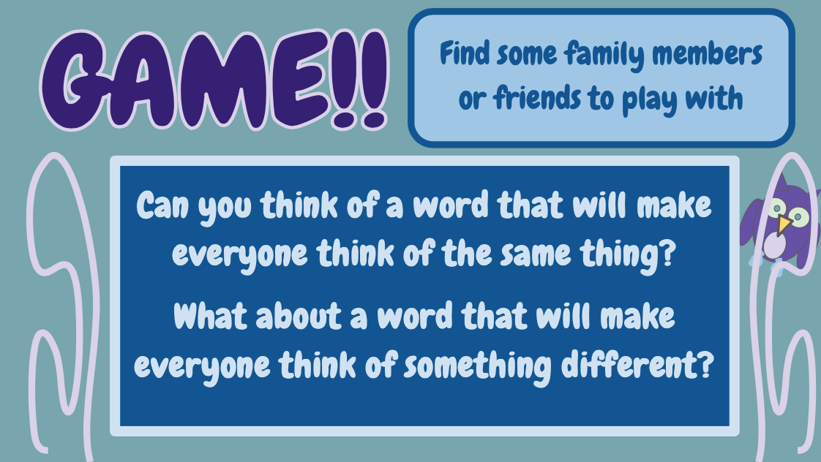
Find some family members or friends to play with
GAME!!
Can you think of a word that will make everyone think of the same thing?
What about a word that will make everyone think of something different?

Slide 7
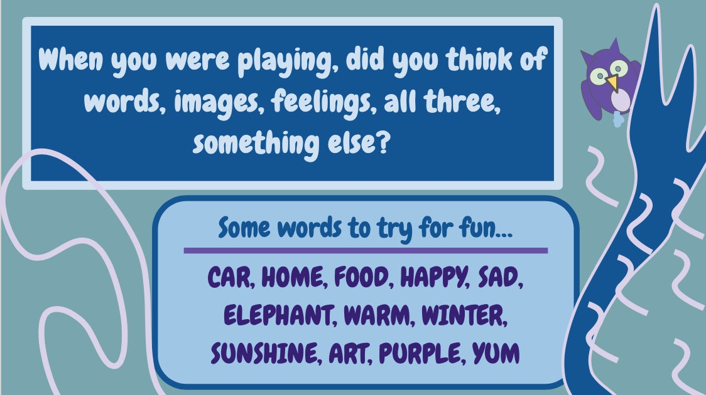

Slide 8


