Slide 1
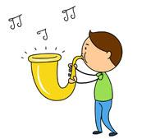
Dancing!

Slide 2
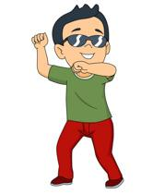
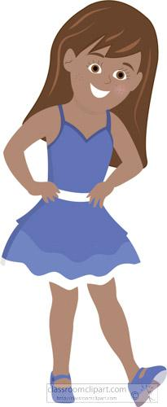
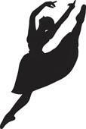
Warm up questions
What is your favorite dance move?
Do you always dance when you listen to music?
Does the way you dance change according to...
Who you are with
Where you are
What songs are playing
Today we are going to think about how our dancing changes for different songs

Slide 3
First, let’s dance to a happy song!
If you have a happy song in mind, play that song and dance!
If not here are some suggestions!
Happy - Pharrell Williams
Walking on Sunshine- Katrina & The Waves
Keep your Head Up- Andy Grammer
Sugar- Maroon 5
Banana Pancakes- Jack Johnson

Slide 4
How did it go?
How did the song make you feel?
Did you express that feeling in your dancing?
Did the song’s lyrics change your dancing?
Did the tempo of the song affect you dancing?
Think about how you moved your body!

Slide 5
Reaction Meter
Use these scales to describe how dancing made you feel
Sad/happy
☹️- - - - - - - - - - - - 😐- - - - - - - - - - - - 😊
Calm/excited
🙂- - - - - - - - - - - - - - - - - - - - - - - - - - -🤪

Slide 6
Now, let’s dance to a slower song
If you have a slow song in mind, dance to that one!
If not, here are some recommendations:
Sweet Creature- Harry Styles
I lived - One Republic (maybe not this song come back to this)
Sunsets for Somebody Else - Jack Johnson
Landslide- Fleetwood Mac

Slide 7
Reaction Meter
Use these scales to describe how dancing made you feel
Sad/happy
☹️- - - - - - - - - - - - 😐- - - - - - - - - - - - 😊
Calm/excited
🙂- - - - - - - - - - - - - - - - - - - - - - - - - - -🤪

Slide 8
How did it go?
How did the song make you feel?
Was your dancing different for the two songs you listened to?
If it was, how was it different?
Why did you dance the way you did for each song?

Slide 9
Wrap Up
Questions to think about:
How do different parts of a song impact how you dance to it? (tempo, tune, lyrics, genre)
How does emotion play a role in dancing?
Can listening to music change how you feel?
Can dancing change you feel?
Think about your favorite song. Next time you dance to it think about how it makes you feel and how you show that feeling in your dancing!

