Slide 1
What is art?

Slide 2
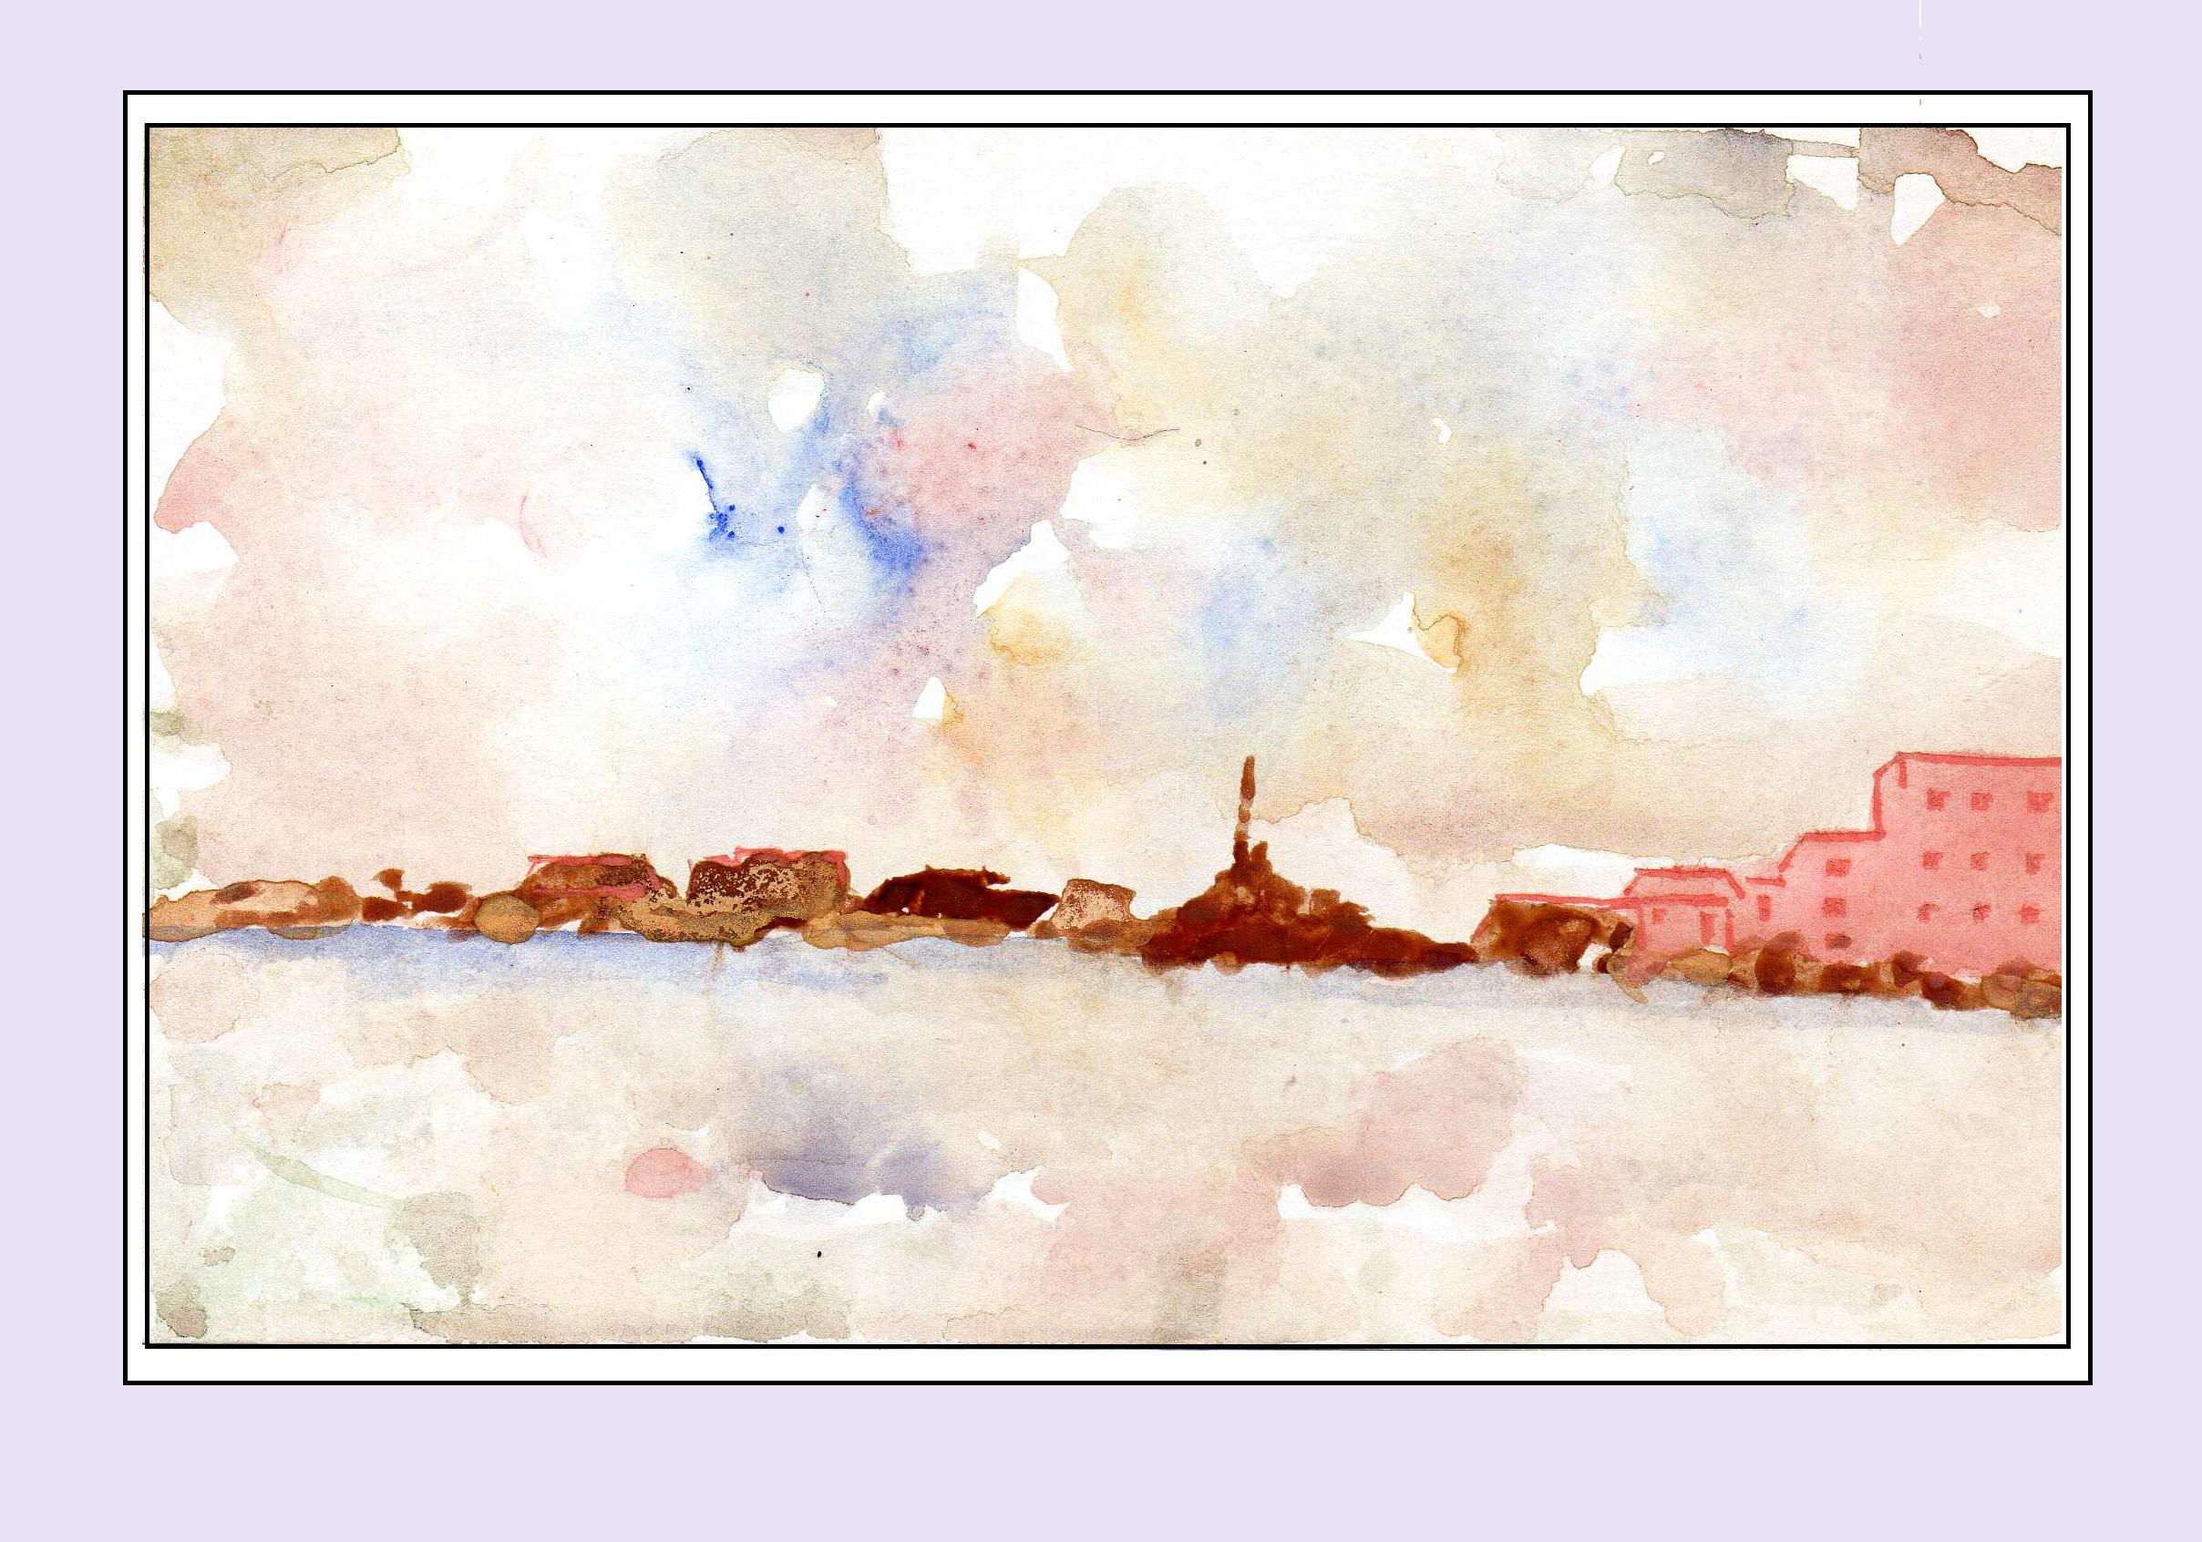
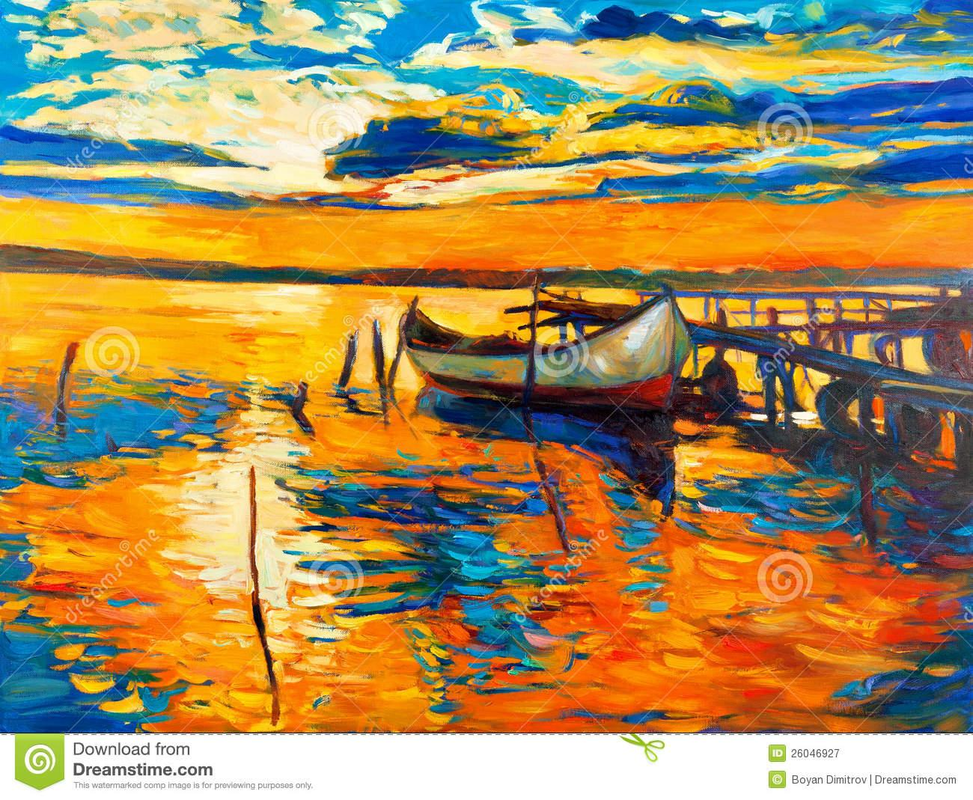
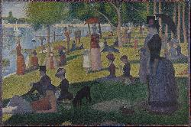
Question of the Day
What is art?
What do you think of when you think of art?
Do you think of examples like these?

Slide 3
What makes an artist an artist?
Are you an artist?
What is art made out of?
What do you do when you make art?

Slide 4
Today we are going to be making art!
But we are going to try it in a new way!
Activity #1
Supplies
1 piece of paper
1 pen or pencil
Any type of colors you want

Slide 5
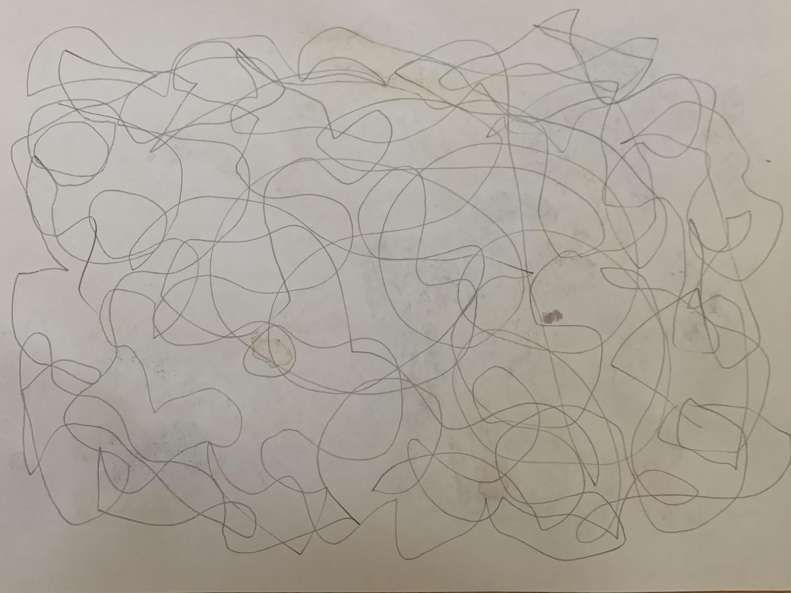
Activity #1
My example:
Take your piece of paper and your pencil
For 1 minute scribble all over the paper
It doesn’t have to look like anything!

Slide 6
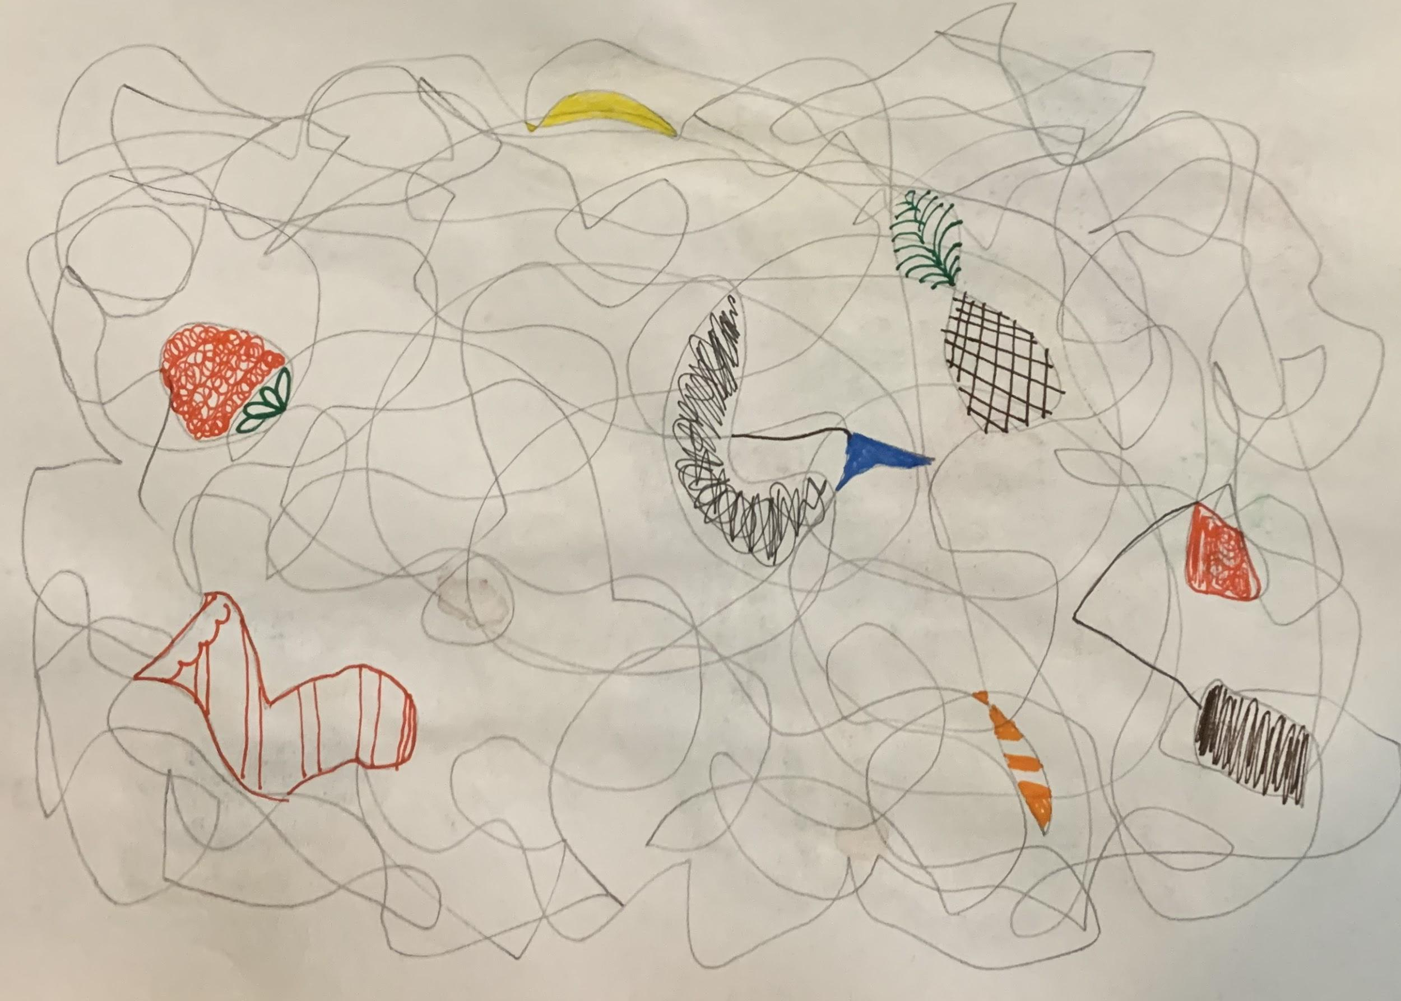
Activity #1
My example:
Your 1 minute is up!
Now, look at your drawing
Do you see an shapes or objects in your picture?
Use your other colors to draw something(s) you see in your original drawing
I drew a strawberry, a stocking, a sailboat, a banana, a pineapple, a fish and a tea bag
What does your final product look like?

Slide 7
Think about it!
Did your final product look like mine?
What was similar about them? What was different?
Have you ever done art like this before?
Do you consider your drawing a piece of art? Why or why not?
If you did this activity again, what would your drawing look like?
Do you think it would look similar or different to the drawing you just did?

Slide 8
Wrap Up
How did you like doing this activity?
Did this change the way you think about art?
What is one thing you learned today?

