Slide 1
Aliens?!?!
What are they? Are they real? Am I an alien??

Slide 2
First, let’s define some things!
What is an Alien?
Write down a list of things that must be true for something to be considered an alien. What’s on your list? Compare with someone around you. Do your lists differ at all? Why might that be?
What makes something alive?
Is a tree or plant “alive”? Does something have to be conscious or have a soul to be considered alive? Why or Why not?

Slide 3
Are aliens real? Take a stance and make a compelling case that would convince someone who holds the opposite opinion.
Jot down a few bullet points and save these for later!

Slide 4
Now, let’s Journal!
Pick a Prompt on one of the 2 following slides

Slide 5
Suppose one night an alien spaceship lands in your backyard. You are the only person on Earth that knows about this. What do you do next?

Slide 6
25 years in the future you are the first human astronaut to take a trip to the planet Saturn. Unbeknownst to the human race, there is an alien civilization living on Saturn called the jujubugs. When you arrive, who are the real aliens: you and your crew or the jujubugs?

Slide 7
Short video on the next slide

Slide 8
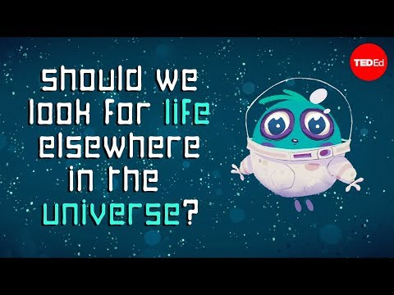

Slide 9
Think and Discuss
Think about the last question posed when the video cut off. Find someone around you (classmate, sibling, parent) and start a conversation with them about these questions:
Suppose we had definitive evidence of alien life, but didn’t know where in the universe it was. Should we go looking for it? Why or why not?
What would the ethical implications be if we did go in search of this alien life?

Slide 10
Finish the video on the next slide.
Write down any immediate reactions/questions that you have. Keep these in the back of your head as you complete the rest of the lesson!

Slide 12
Recall your answer to the question from earlier: Are aliens real?
Can you say this with absolute certainty? Why or why not?
Consider the evidence you jotted down earlier. Where did you get this information? How did it come to you? Do you notice any bias in your sources?
When will you be able to confidently conclude that there are (or are not) aliens?
Is one of these harder to prove than the other? Why?

Slide 13
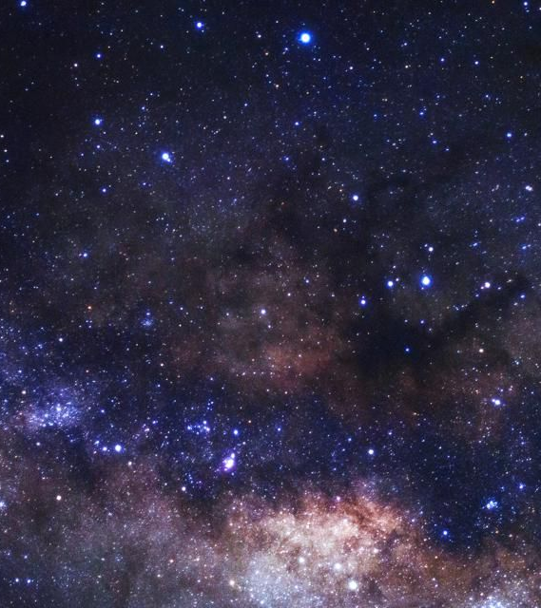
Going forward, try to think about other problems/scenarios in your life to which you can apply this epistemological and ethical frameworks.
Consider these questions:
Where/how/from whom do I get my information?
What evidence do I need to confidently make a claim, and when does this claim become knowledge?
How do my claims and/or actions affect others?

