Slide 1


Slide 2
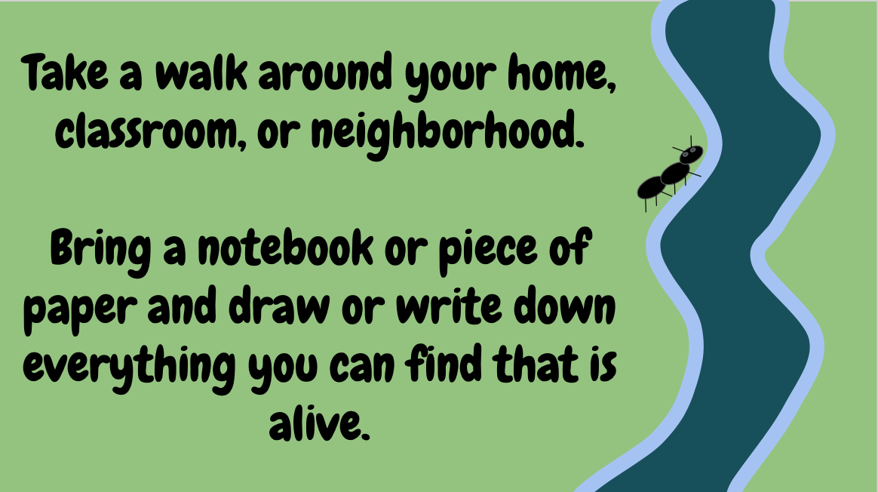

Slide 3
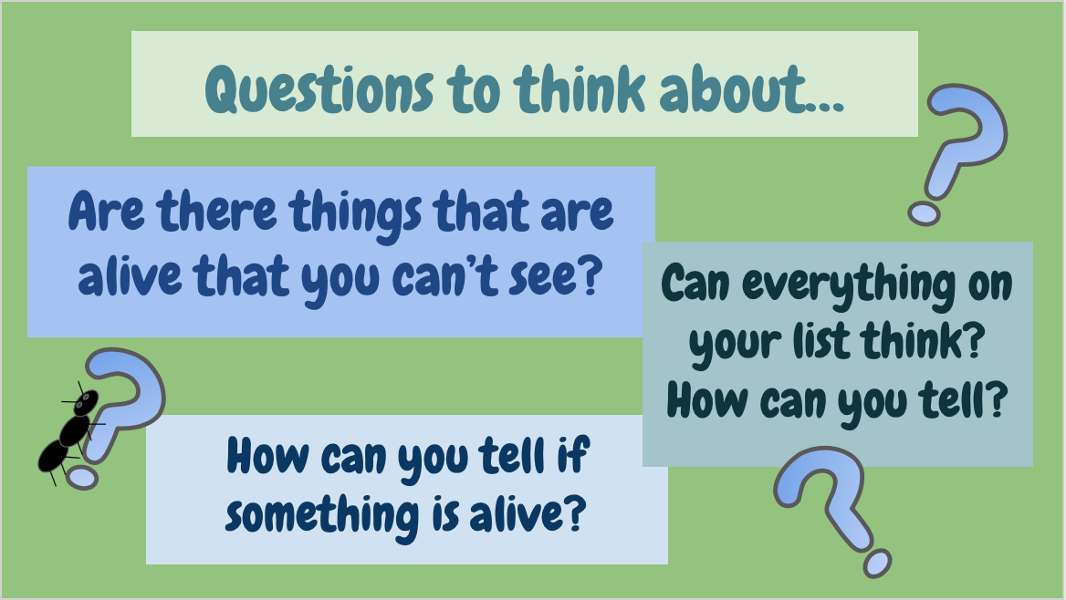

Slide 4
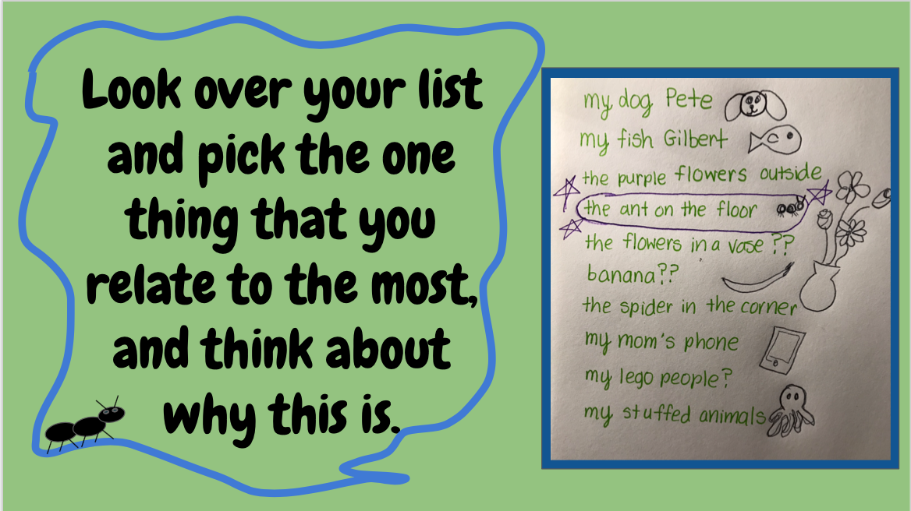

Slide 5
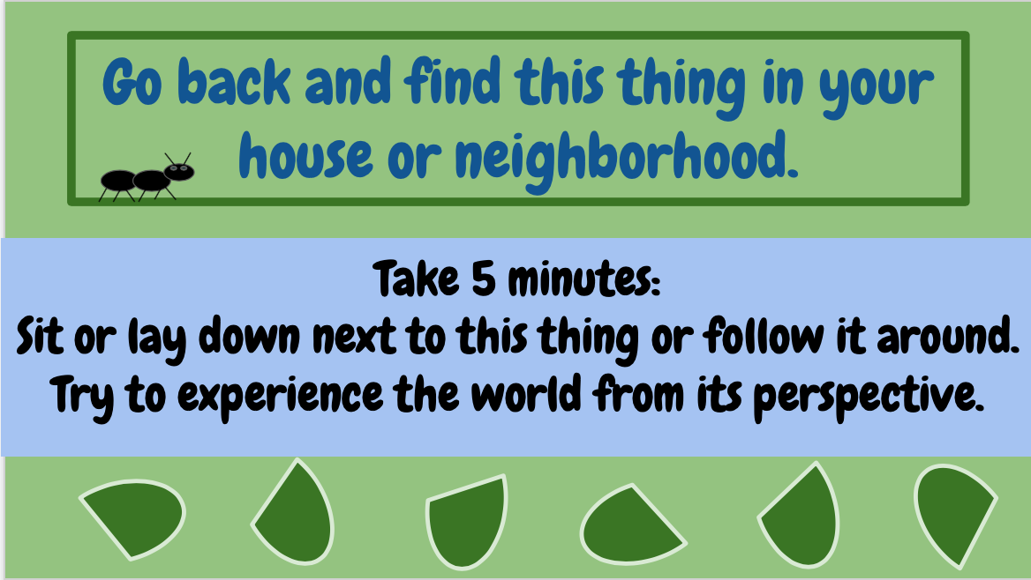

Slide 6
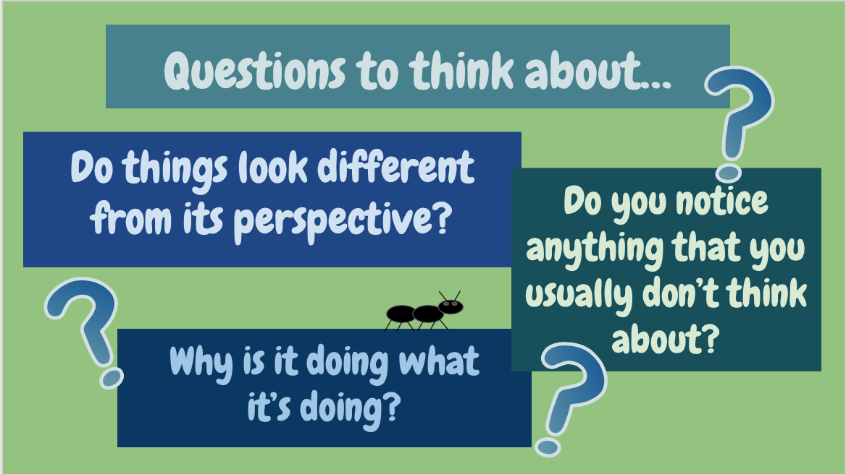

Slide 7
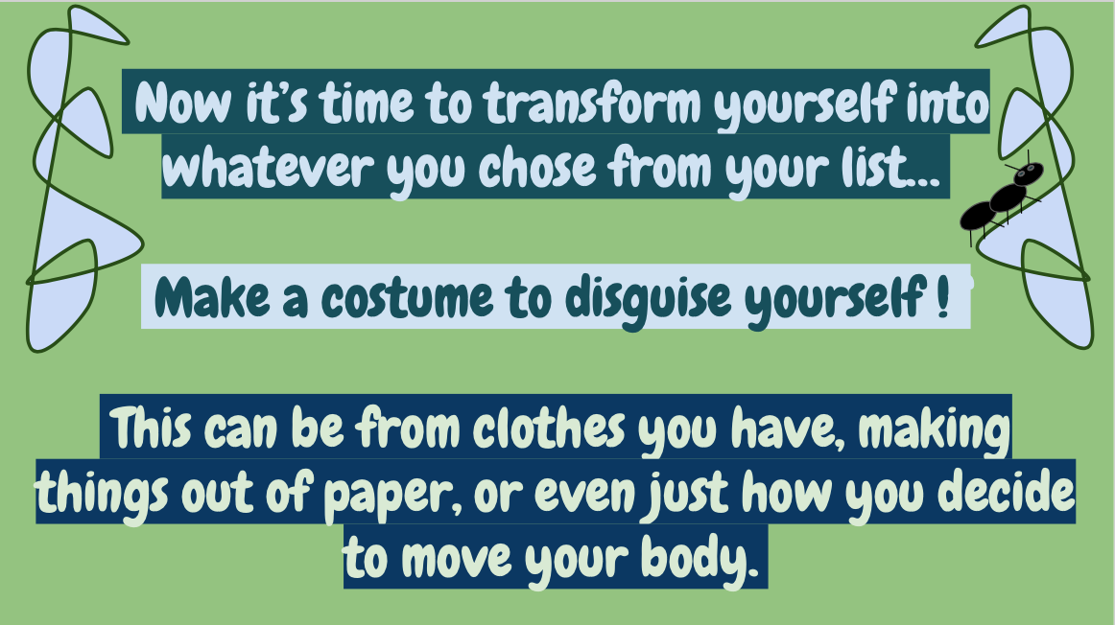

Slide 8
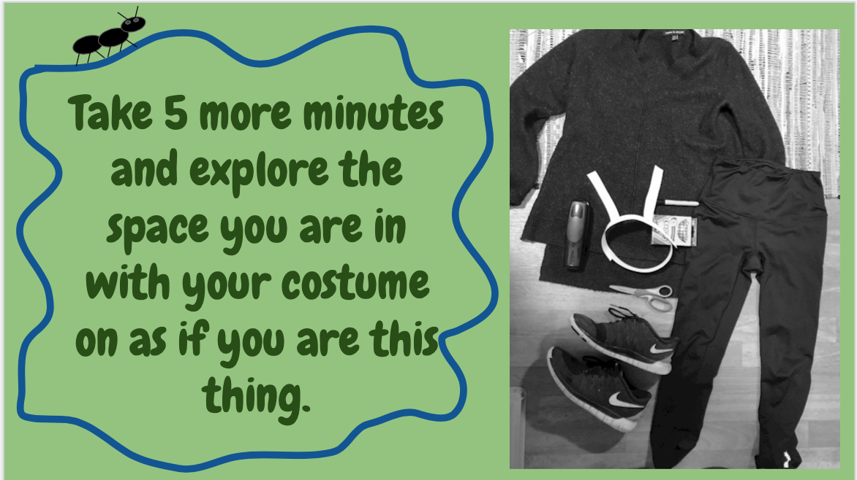

Slide 9
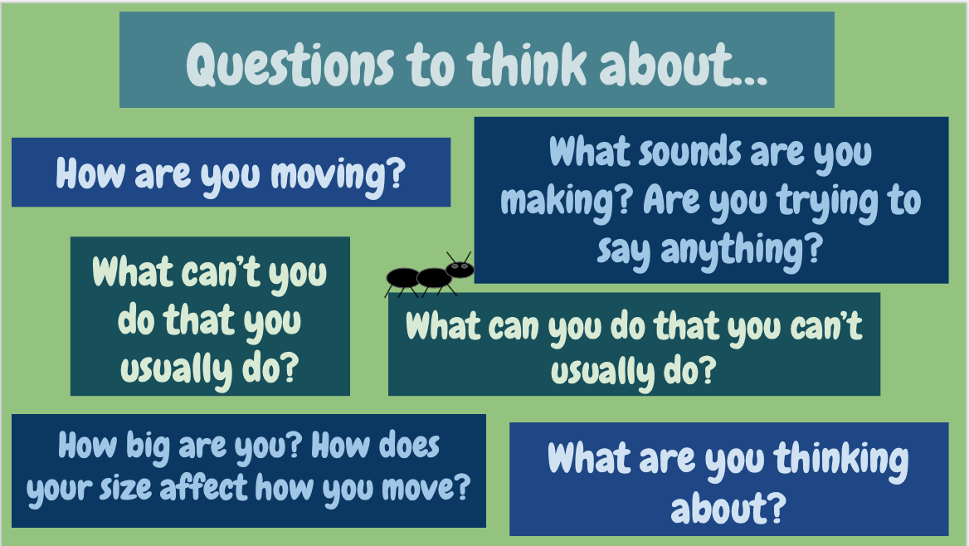

Slide 10
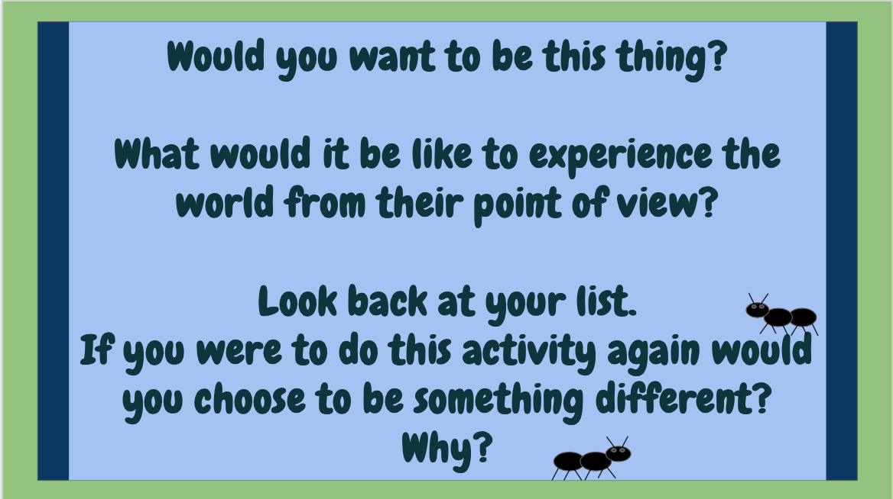

Slide 11
Other Fun Ideas!!
Draw a picture of what your home, classroom, or neighborhood look like from the perspective of the thing you chose.
Show a friend or family member the list you made, and ask them what they relate to the most from it. Talk about why their choice is the same or different from yours.

Slide 12
