Slide 1
What would a Stoic do?
Series of Questions

Slide 2
-Epictetus. Discourses. II.5
The chief task in life is simply this: to identify and separate matters so that I can say clearly to myself which are externals not under my control, and which have to do with the choices I actually control.

Slide 3
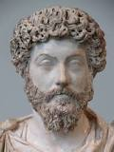
What would Stoic do?
Just got a tasty hamburger and while trying to eat it drops it on the ground!

Slide 4
What would a Stoic do?
Went on a run and then it suddenly starts raining

Slide 5
What would a Stoic do?
Driving to school or work when suddenly someone runs a red light and crashes into you.

Slide 6
What would a stoic do?
Going to a wedding but the flight you’re taking gets canceled

