Slide 1
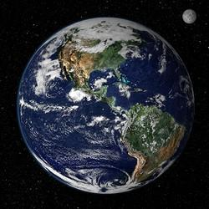
Google Earth Adventure

Slide 2
Warm Up Question
Where do you live?
What street do you live on?
What town do you live in?
What state do you live in?
What country do you live in?
What do you live near? What is around you?

Slide 3
Warm Up
There are so many different ways to answer this question!
What is your most specific response and what if the least specific response?
My example responses:
About a 5 minute drive from the beach
In a yellow house
Right by Northwestern
University
On Isabella Street
In the United States
All of these are accurate responses to this question, but they give very different information.

Slide 4
What are we doing today?
Today we are going to talk about different locations on earth.
We are going to go on an adventure all around!
Goal: Think about all the different ways we can describe a location.
Let’s Go!

Slide 5
Today we are going to be exploring Google Earth!
Go to earth.google.com and click the “Launch Earth” button
First, Explore!
Move around! Find somewhere random and zoom in. Drag and drop the little person icon to look at the street view. What do you see? Are there people around? Roads, houses, nature?
Zoom back in and try this again! See how many different environments you can find!

Slide 6
Google Earth Adventure
Next we are going to try to find different things on Google Earth!
Try to find the items in the table on the next slide.
If you want, try to see how many countries you go to while exploring!

Slide 7
What can you find on your Google Earth Adventure?
What can you find?
Extra Challenge:
Animal | Person | Beach
Forest | Mountain | Road
Building | Snow | Island
Boat | Volcano | Airplane
Billboard | Car | Cow
Something you’ve never seen before | Something you see everyday | Somewhere new

Slide 8
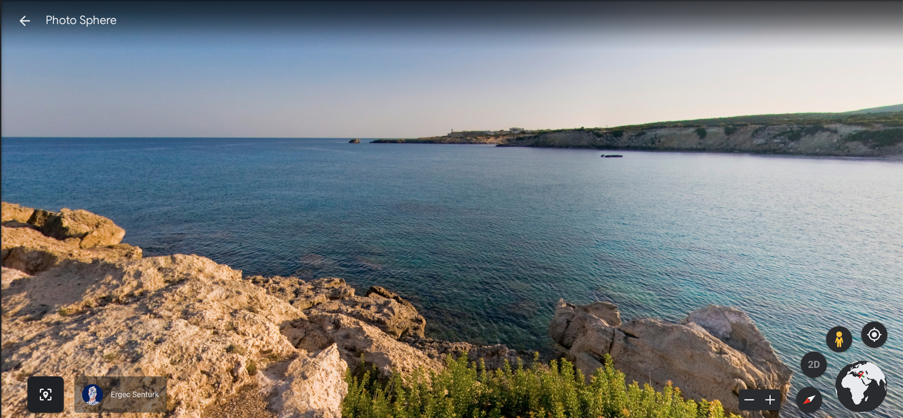
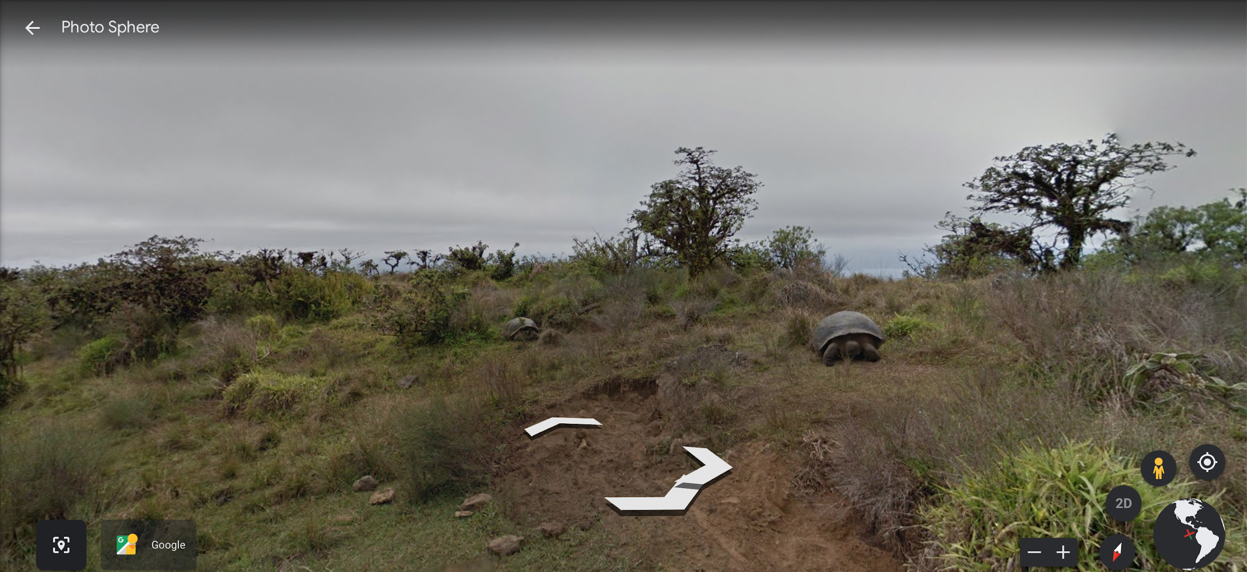
Example Adventures
Cyprus
Galápagos Islands
Look at the tortoises!

Slide 9
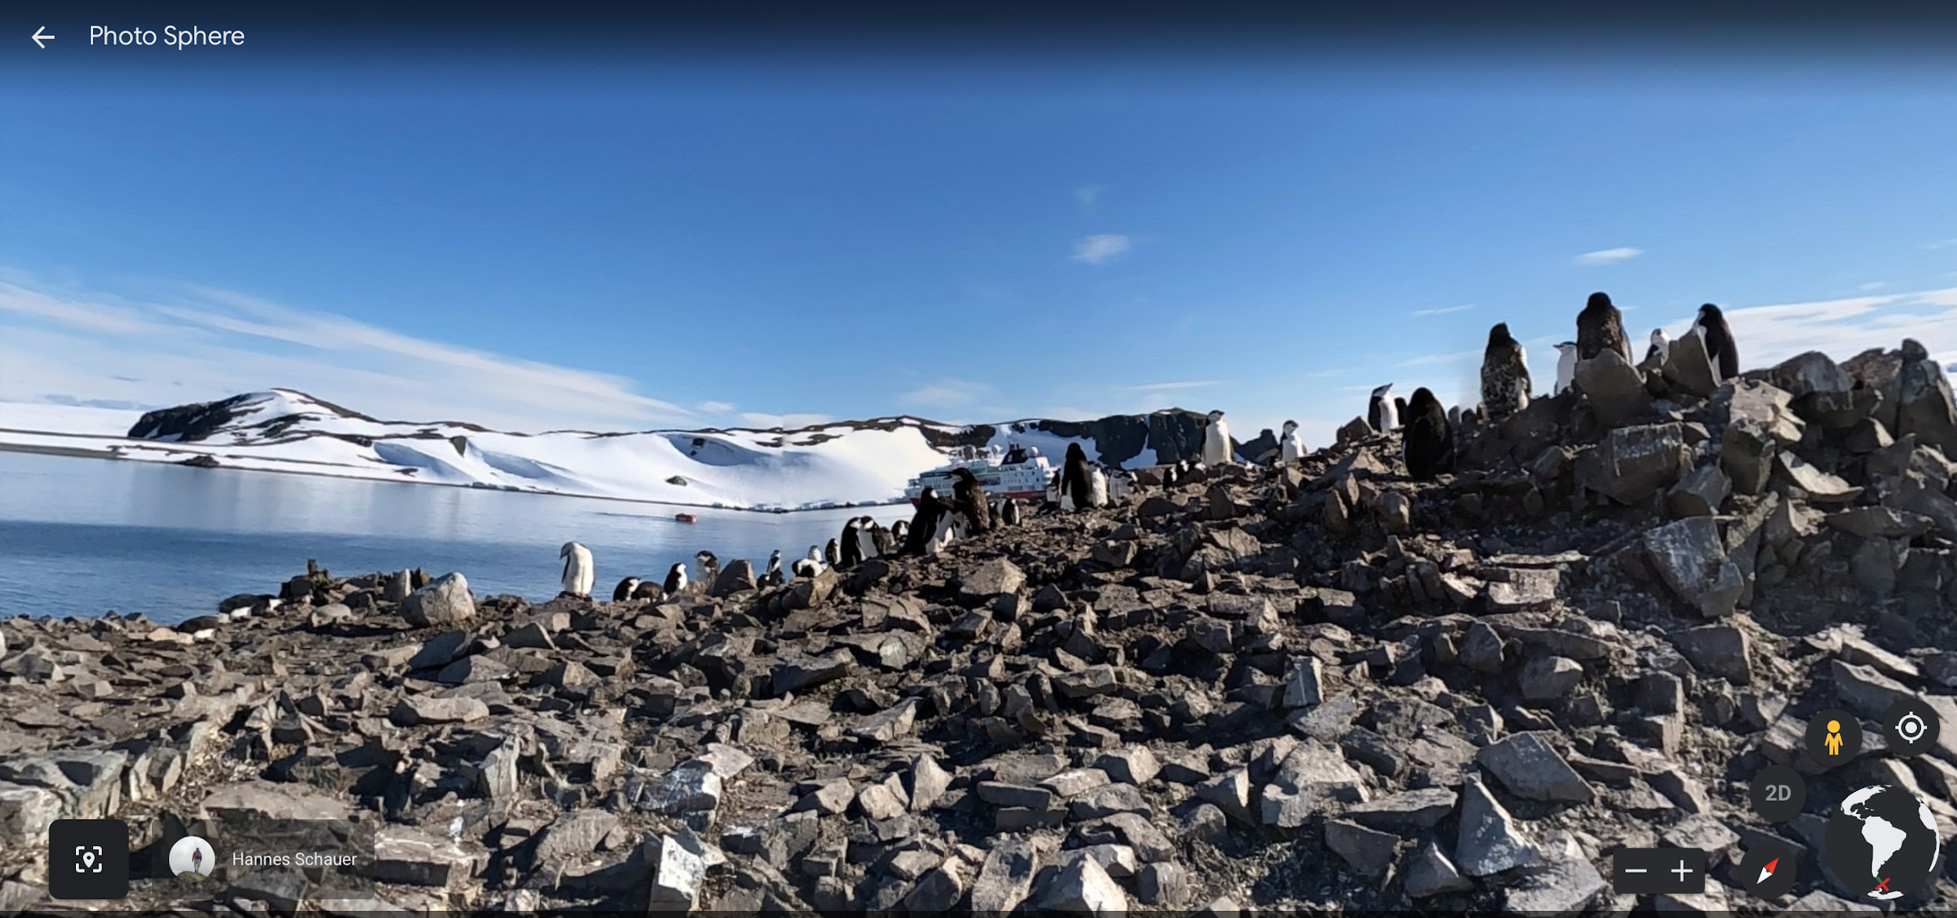
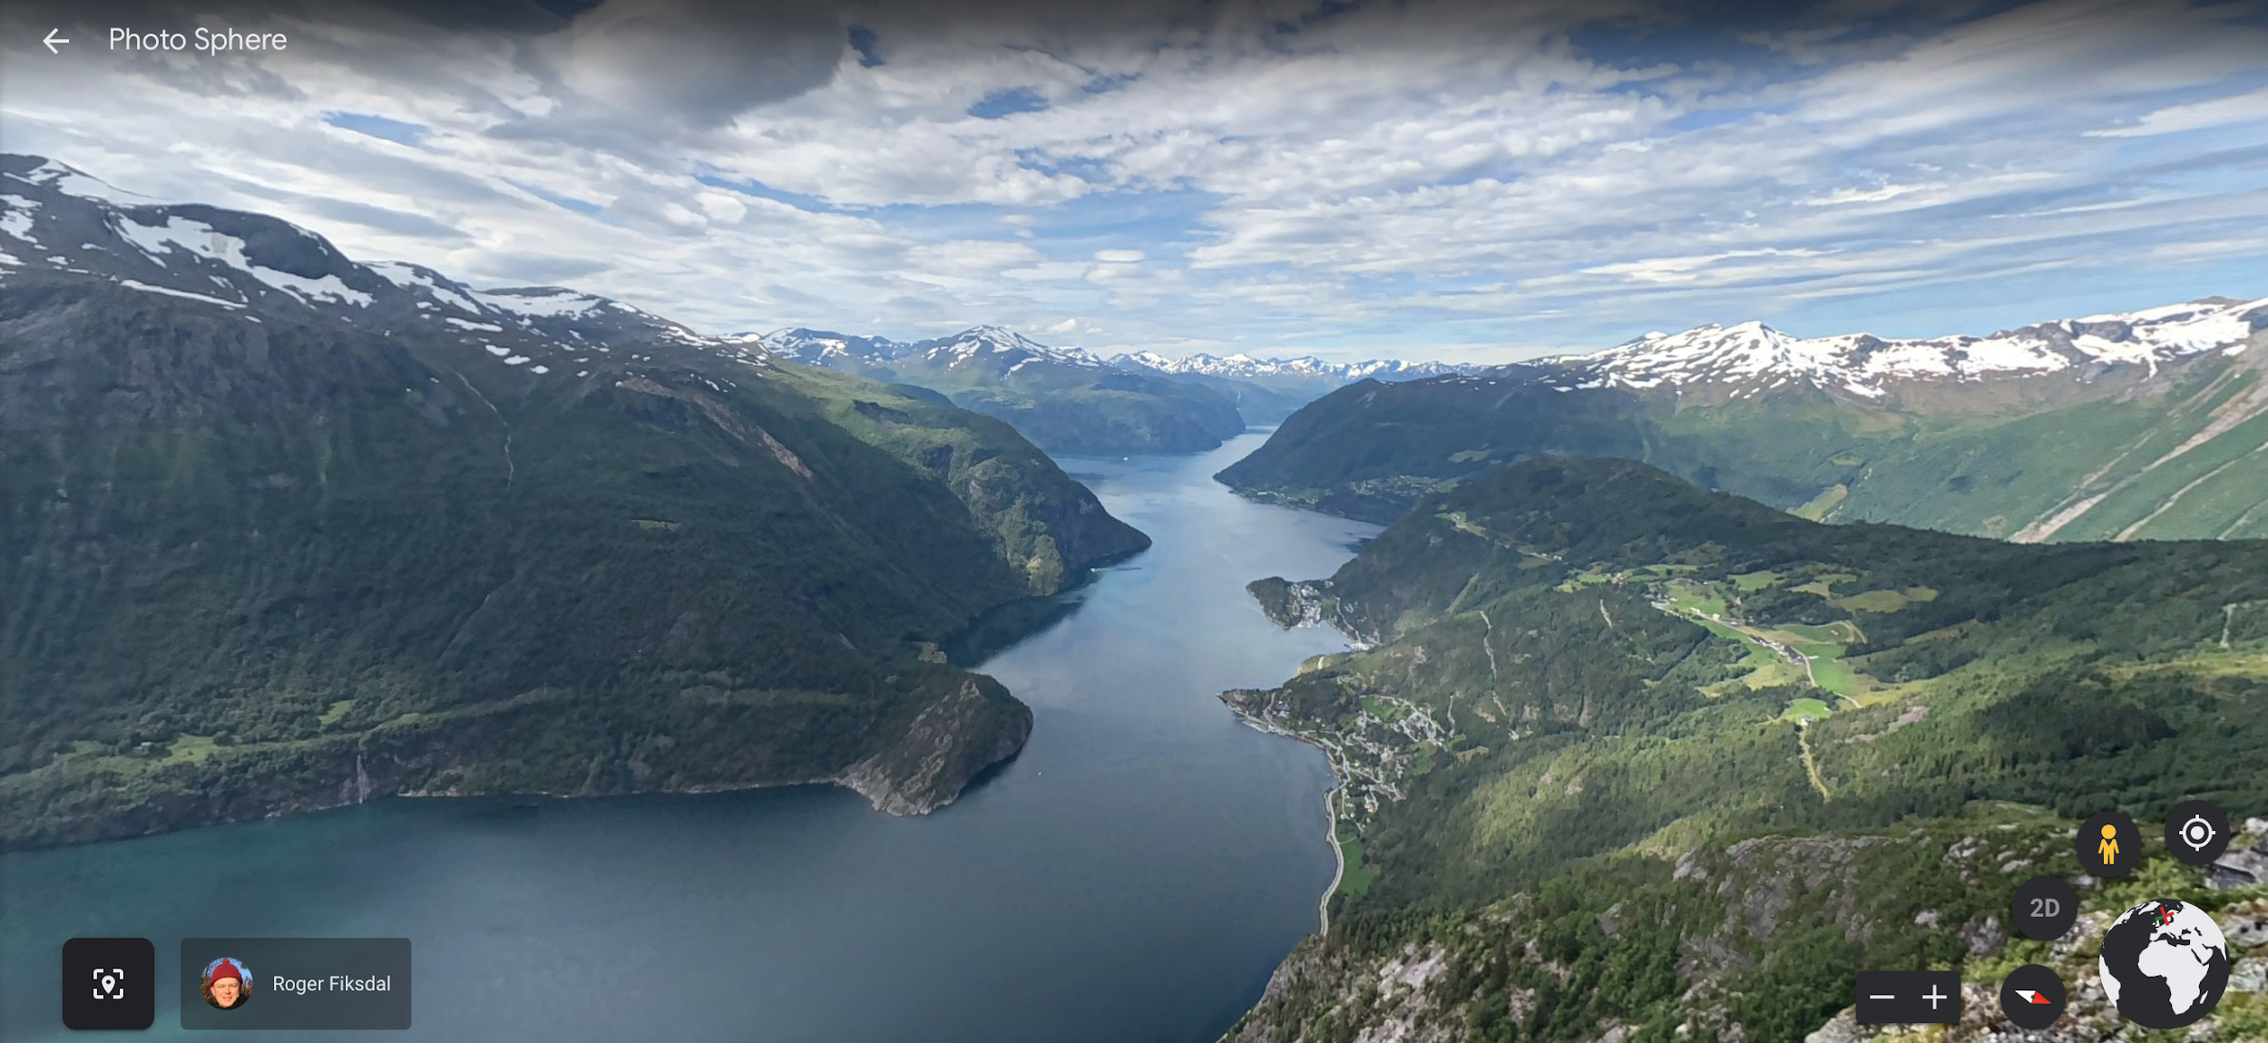
More Example Adventures
Penguins!
In Antartica
Mountains in Norway

Slide 10
Reflection
Did you have fun on your Google Earth Adventure?
What was your favorite thing you found?
What’s the difference between visiting a place on google earth and visiting in person? Do you think you’ll ever see these places in person?
Were the places you looked at close to where you live?
Did you know all these places existed before this activity?
What are three things you learned about the world from this activity?

