Slide 1
Intro to Epistemology
How do we know what we know?

Slide 2
What is Epistemology?
Episteme (Greek: επιστημη) = knowledge
Logia (Greek: λογια) = study
… The study of knowledge!

Slide 3
Quick Think-To-Yourself Activity!
Can you think of 3 things you know? (write them down if you want!)
What about 3 things you think you know?
3 things you believe?
Now, something you know that you don’t know?

Slide 4
Discuss!
Find a classmate, family member, anyone! Share your ideas!
What are the differences between your beliefs and your knowledge?
What makes something a belief and not absolute knowledge?

Slide 5
Brainstorm!
Come up with some criteria that something must meet for it to be considered knowledge. Write it down!

Slide 6
What do the Philosophers Say?
Traditionally, knowledge has been defined as Justified True Belief.
Justified: because you have some evidence to support it
True: because it aligns with reality
Do your examples from earlier fit this definition? Do you agree with this definition of knowledge? Why or why not?

Slide 7
Find a quiet place and watch the video clip on the next slide! (it’s supposed to start at 5:44 and end at 8:42)

Slide 8
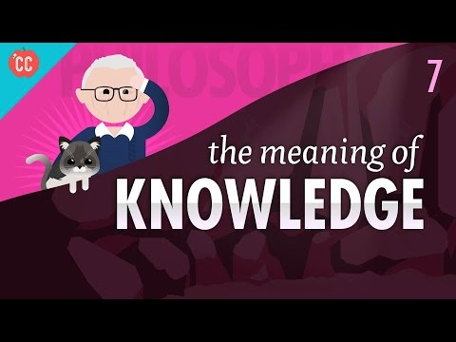

Slide 9
Come up with some Gettier examples of your own!
Reminder: A Gettier example is a situation in which someone can have justified true belief but not knowledge
Have fun with it! How creative can you get? Can you think of one that applies to your own life?

Slide 10
So, what is knowledge?
… and can you even truly know what knowledge is?

