Slide 1
Are We Living in a Simulation?
And what would it mean if the answer is yes?

Slide 2
Think About It.
On the next 2 slides you will watch 2 videos about reality as we know it.
Grab a piece of paper and jot down the first things (questions, thoughts, etc) that pop into your head as you watch. There are no right answers - just write down everything you think of.

Slide 3
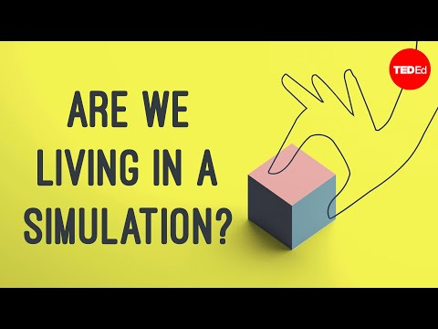

Slide 4
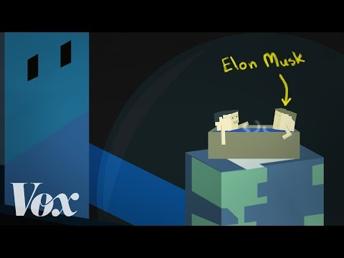

Slide 5
Questions to Reflect on:
Do you agree or disagree with Elon Musk: Do you think we are living in a simulation?
If yes, why?
If no, what evidence do you have to prove that this is “face reality”?

Slide 6
Compile Some Evidence:
Jot down a list of reasons why we could be living in a simulation and a list of reasons why we can’t be.
Which list is more compelling? Why?

Slide 7
Journaling Activity:
Choose one of the following prompts on the next slides, take 10 -15 minutes, and write about it:

Slide 8
Prompt #1
Assume that we are, in fact, living in a computer simulation. Do our actions have consequences? Why or why not? How would you change the way you live your life given this knowledge?

Slide 9
Prompt #2
You have just built the world’s best running supercomputer/virtual reality system and all of the gaming companies are looking to you to make the next big game. What would you design? Would you ever want to make a simulation of reality so complete it was indistinguishable from the real thing? Why or why not?

Slide 10
Prompt #3
There’s a new virtual reality game so detailed and complete, it is rumored to feel just like real life. You get this system as a birthday present and discover the rumors are true! You can even eat food in this game and taste the flavors. The virtual world is much more peaceful and enjoyable than the real world is. Would you ever leave the game? Why or why not?

Slide 11
Prompt #4
Would knowing that you live in a simulation change your experience of playing video games? Do you think it's possible that the characters in them are real?

Slide 12
Talk with Someone:
Find someone around you (parent, sibling, classmate, friend, Siri, pet, etc…)
Talk with them about their opinions on life being a simulation. Do they differ from yours? What types of evidence do you both have to support your points?
Try pushing the discussion further. For example, if someone says they know life is real because they have free will, ask them if they know that, or if it’s just a belief they hold.

Slide 13
Wrap-Up and Closing Questions:
What do you think: Is this all real, or is life as we know it just a simulation? And does that really matter?
Would knowing the absolute answer change the way you live your life?

