Slide 1
Epistemology: Let’s Think About it!
Is anything you know really real??

Slide 2
Quick Recap!
What is Epistemology??
→ Epistemology is the study of knowledge!
(or more specifically: how do we know what we know?)

Slide 3
Think About It!
Think of 3-5 things that you know.
How do you know them? (write it down if you want!)
Are you sure that you know them? Do you have any doubts at all?
If yes, what are you unsure about?
If no, what makes you so confident in your claims?

Slide 4
Discuss!
Find a family member, friend, classmate, anyone! Share your responses with them!
Discuss any doubts you have about your knowledge and where you think they might come from. Are you more confident with certain types of knowledge than with others?
If so, why do you think that is?

Slide 5
Thought Experiments!
Here you will be presented with a few thought experiments. Think about them, write about them, discuss with someone - do whatever interests you!

Slide 6
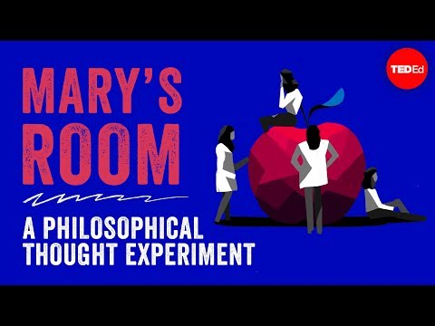
Mary’s Room

Slide 7
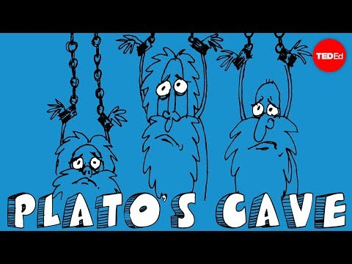
Plato’s Allegory of the Cave

Slide 8
Russell’s “5 minute hypothesis”
“How can you be sure that the world did not spring into being five minutes ago, exactly as it then was, with a population that “remembered” a wholly unreal past?”
Source: Bertrand Russell. The Analysis of Mind. 1921. London: George Allen & Unwin, 1968. 159.

Slide 9
Do you really know what you know?
Can you ever really be sure?

