Slide 1
Word Challenge
How do we use our words differently?
A K-12 Philosophy lesson on Language and Thought

Slide 2
Challenge #1: Word Search
Set a timer for 5 minutes!
Find as many words as you can in the puzzle on the next slide and write them down

Slide 3
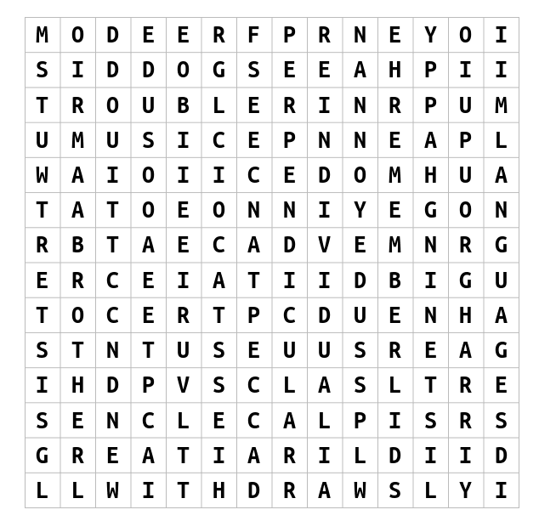

Slide 4
Which words did you find?

Slide 5
Ask yourself:
Write it down:
Why do you think you found some words but not others?
Did you have a strategy?
Do you use these words often?

Slide 6
Which words did you NOT find?
freedom
happy
brother
water
cats
perpendicular
great
dogs
acceptance
sister
individual
listening
music
language
help
group
trouble
remember
annoyed

Slide 7
Ask yourself:
Write it down:
Which words did you NOT find?
Why do you think you missed these words?
Do you use these words often?

Slide 8
Challenge #2: Word Connection
Set a timer for 2 minutes!
Write as many words as you can that come to mind when you read the word on the next screen

Slide 9
Powerful
Reminder: write down any words you think of when you hear “powerful”

Slide 10
Reflect
Which words did you write down?
Why do they remind you of the word “powerful”?
Do you think your friends and family would think of different words?
Why or why not?

Slide 11
Wrap-up Brainstorm:
Where do we get our words from?
Do you use different words at home than you do in class? With friends?
Is there one, right way to use our words?

Slide 12
Challenge #3: Word Challenge Journal!
Step 1: Ask 3 of your friends/family members what words come to mind when they think of the word “powerful” (or another word of your choice)
Step 2: Write your answers in your Word Challenge journal (along with your own answers).
Step 3: Once you have collected your answers, write down 3 observations about all of the answers you collected.

